Slide 1
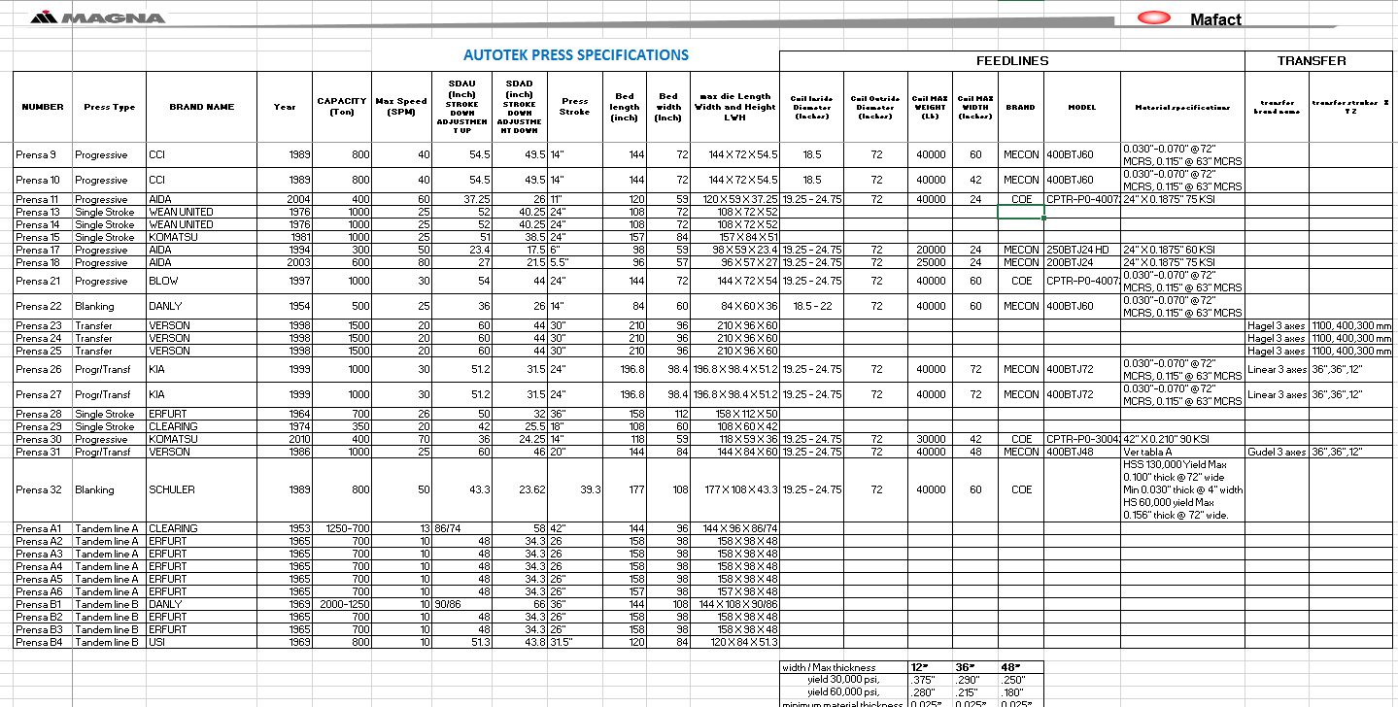
ATK PRESS.
Revisión 11.2
25/10/18

Slide 2
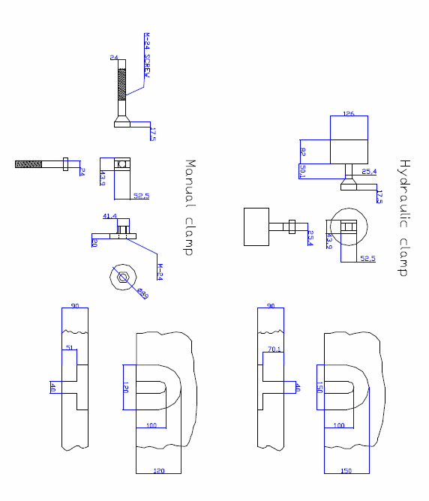
Upper Clamping
150
73.0
71.5
Lower Clamping

Slide 3
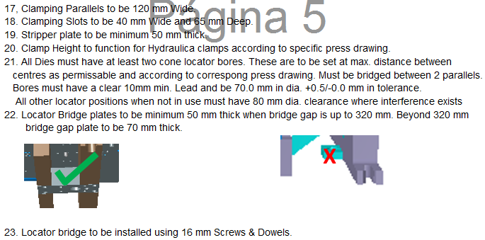
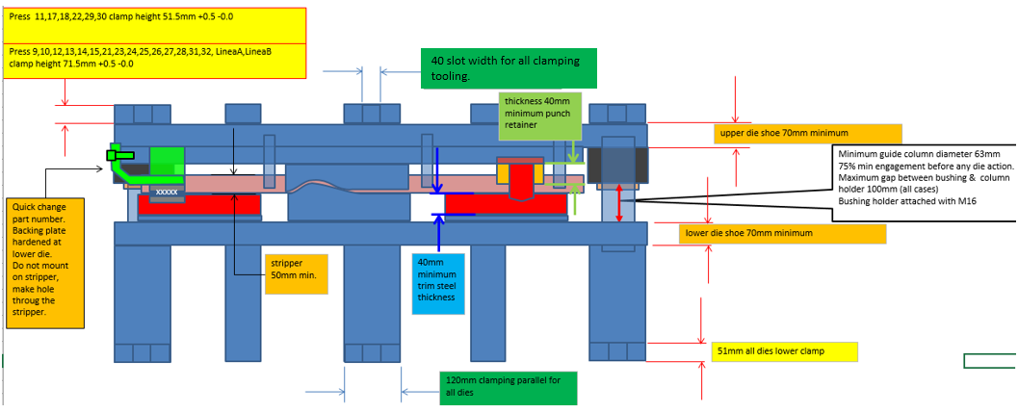

Slide 4
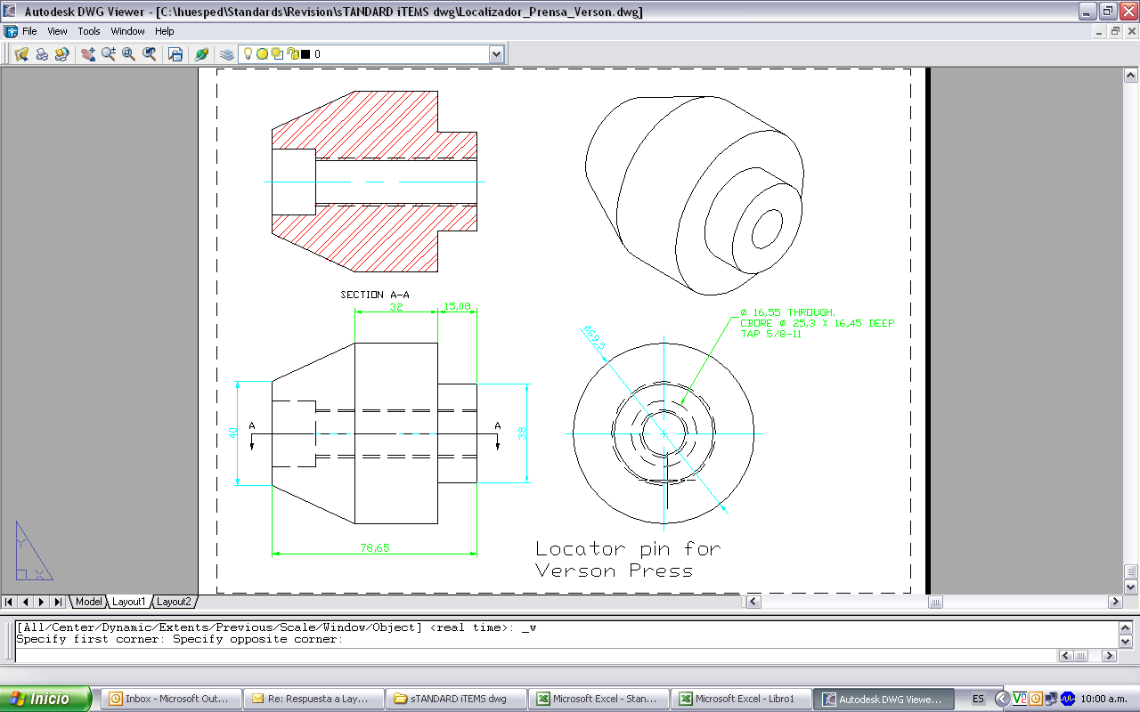
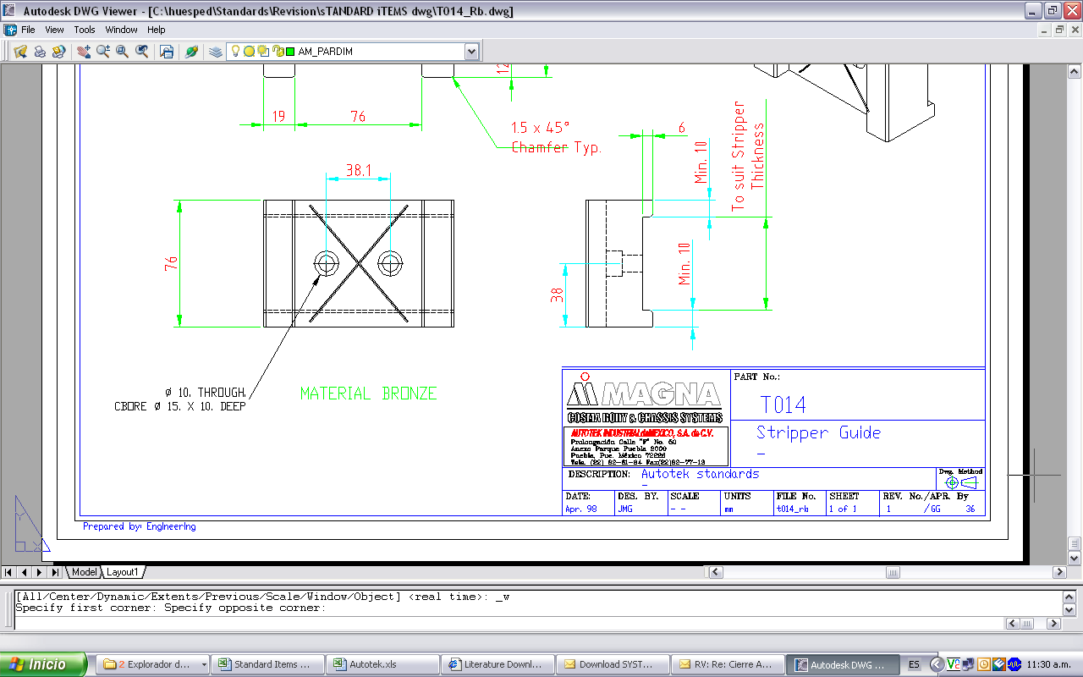
25.0
25.0
69.5
+0/-0.5
40
44.3
+0/-0.2
T020
80.0
Press Locator
Press 9,10,21,23,24,25,26,27&31

Slide 5
25.0
25.0
M 16 TAP
30mm DP
59.5
+0/-0.5
40
40.0
+0/-0.5
T021
80

Slide 6

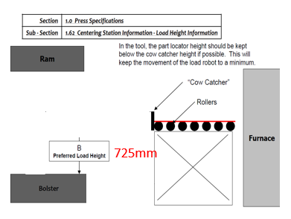
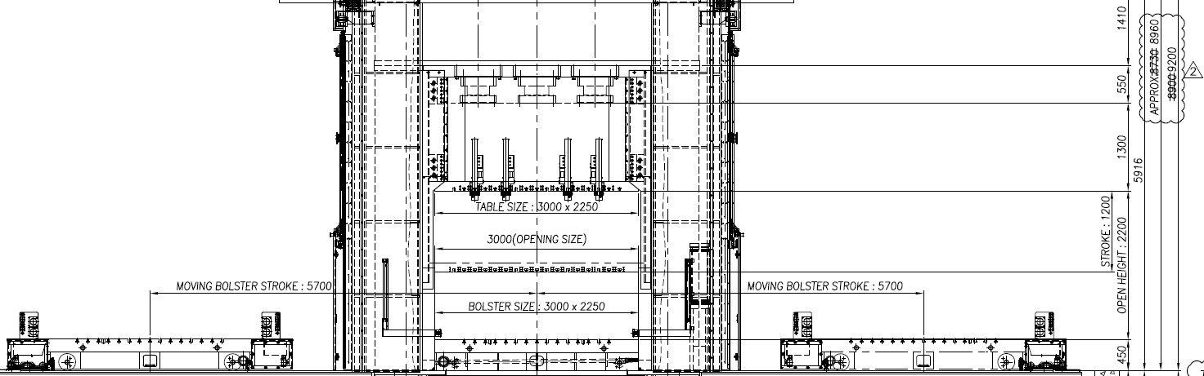

Make | Model | Bolster Size | Tonnage (metric) | Press Frame | Drive | SPM | Clamp Slot Pitch | Max. Shut Height | Min. Shut Height | Preferred Shut Height | Slide Stroke-(mm) | Bolster Capacity (kg) | Max Upper Die Weight (kg) | Auto Camps | Rolling Bolster Window | Furnace Layout
WIA | 1200 T | 3000mm x 2250mm | 1200 | Mono block | Hydraulic | 20 SPM | 152.4mm | 2200mm | 1000mm | 1200mm | 1200mm | 30,000 | 15,000 | Positions 0/3/6/-3/-6 | 2300mm x 2650mm | Double Roller Hearth
HS
PR HOT STAMPING
Common Shut Height

Slide 7


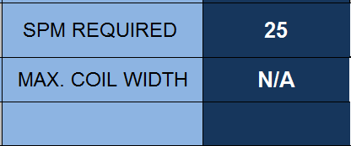
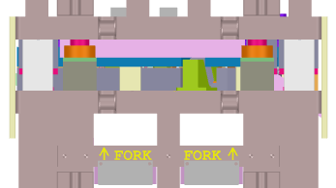
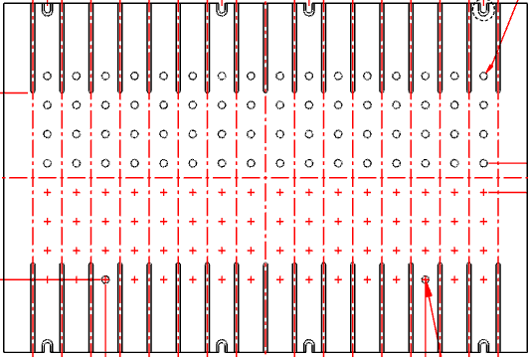
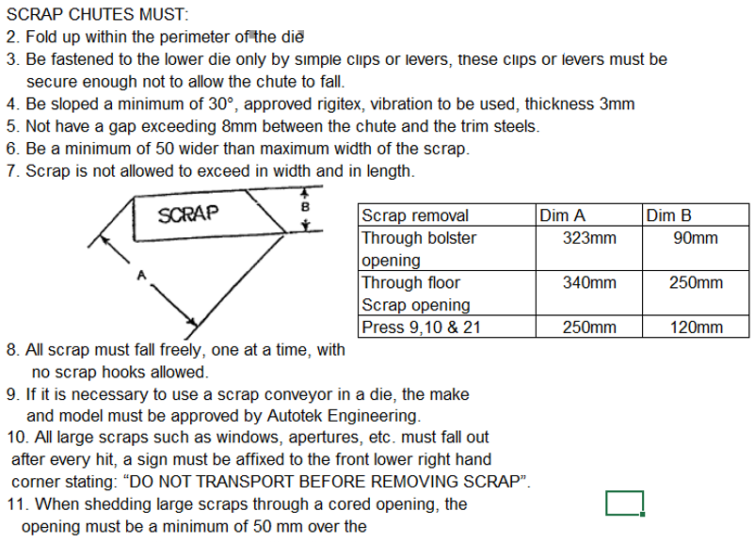
Press | Type | BOLSTER L-R | BOLSTER F-B | Common Coil Feed Height to Bols | STROKE | Common Shut Height | Minimum Shut Height | Maximum Shut Height | Ram Adjust | TONNAGE
PR13/PR14 | MANUAL | 2743 | 1829 | 635 | 610 | 1194 | 914 | 1321 | 406 | 1000
PR13,PR14
Manual.
Image with closed press
2743.2mm
1194mm
Common Shut Height
FRONT FLOW
1828.8mm
152.4mm
Distance between slots 6”
533.4mm
1676.4mm
Distance between locator

Slide 8
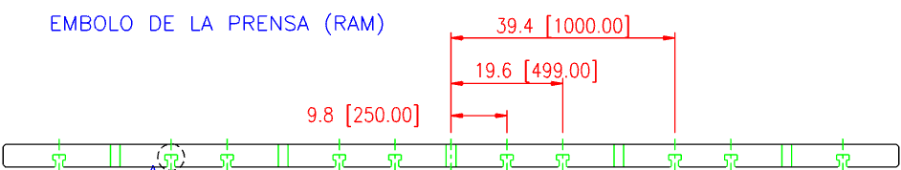
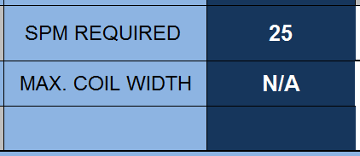
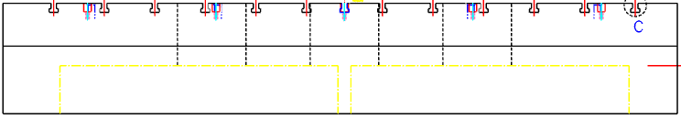
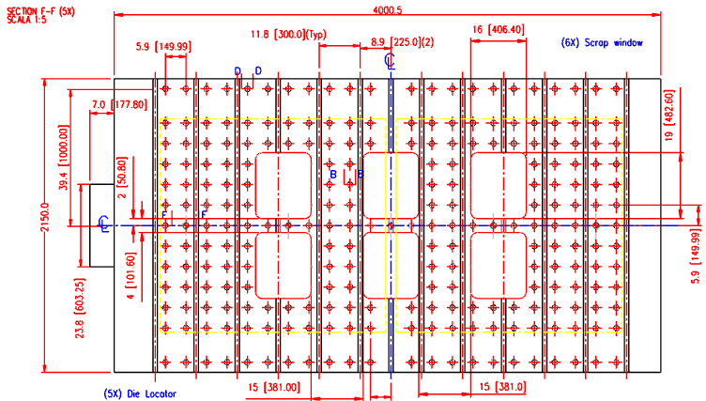
Press | Type | BOLSTER L-R | BOLSTER F-B | Common Coil Feed Height to Bols | STROKE | Common Shut Height | Minimum Shut Height | Maximum Shut Height | Ram Adjust | TONNAGE
PR15 | MANUAL | 3988 | 2134 | 914 | 600 | 1194 | 991 | 1295 | 304 | 800
PR15
Manual.
Image with closed press
Common Shut Height
1194mm
FRONT FLOW
225mm
300mm
Distance between slots

Slide 9

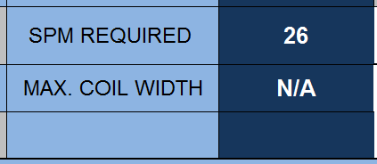
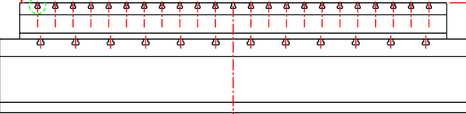
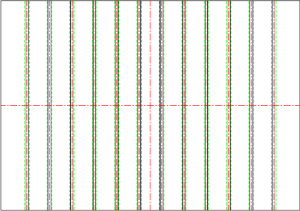
Press | Type | BOLSTER L-R | BOLSTER F-B | STROKE | Common Shut Height | Minimum Shut Height | Maximum Shut Height | Ram Adjust | TONNAGE | Minimum Strokes P/Minute | Maximum Strokes P/Minute
PR28 | MANUAL | 3658 | 2438 | 950 | 1194 | 813 | 1270 | 457 | 700 | 0 | 4
PR28
Manual.
Image with closed press
Common Shut Height
1200mm
3658mm
FRONT FLOW
FRONT FLOW
2438mm
300mm
Distance between slots

Slide 10
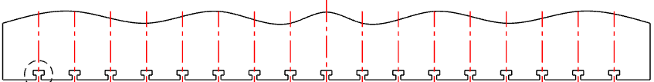
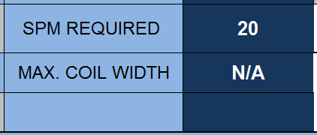
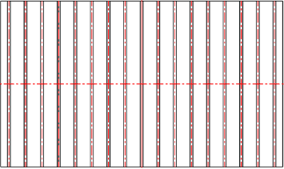
Press | Type | BOLSTER L-R | BOLSTER F-B | STROKE | Common Shut Height | Minimum Shut Height | Maximum Shut Height | Ram Adjust | TONNAGE
PR29 | MANUAL | 6480 | 1524 | 457 | 787 | 660 | 1041 | 381 | 350
PR29
Manual.
Image with closed press
Common Shut Height
780mm
6480mm
FRONT FLOW
1524mm
Distance between slots
300mm

Slide 11
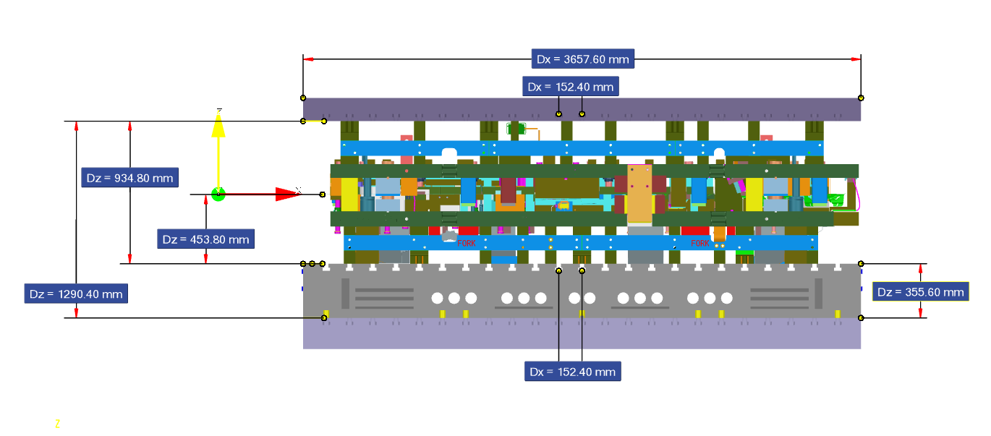
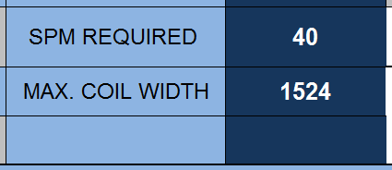
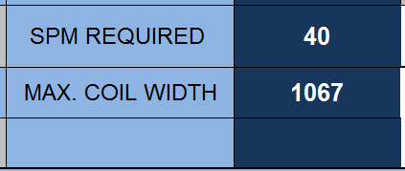
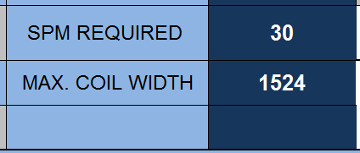
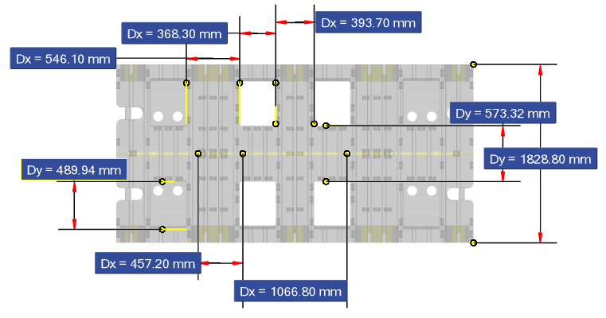
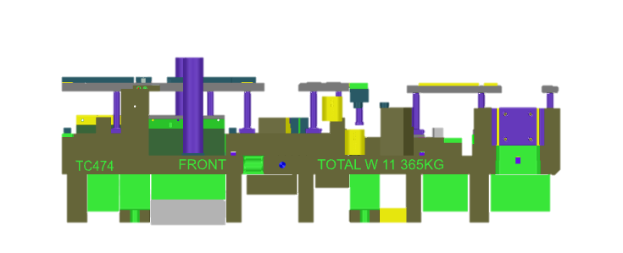
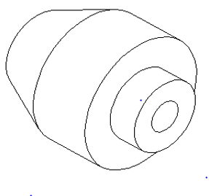
PR09,PR10,PR21
Press | Type | BOLSTER L-R | BOLSTER F-B | Common Coil Feed Height to Bols | STROKE | Common Shut Height | Minimum Shut Height | Maximum Shut Height | Ram Adjust | TONNAGE | Minimum Strokes P/Minute
PR09,PR10 ,PR21 | PROG | 3658 | 1829 | 500 | 356 | 934 | 1245 | 1372 | 140 | 800 PR21,1000 | 20
PROG
Image with closed press
Common Shut Height
PR09
934
PR10
PR21
FRONT FLOW
Distance between slots 6”
Common coil feed height with lifters extended
Riser
500mm
Locator T020
Distance between locator .

Slide 12
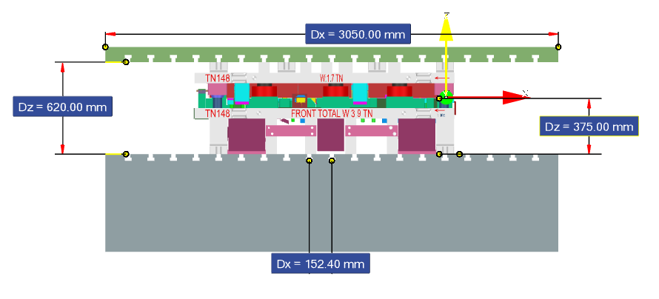

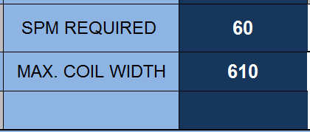
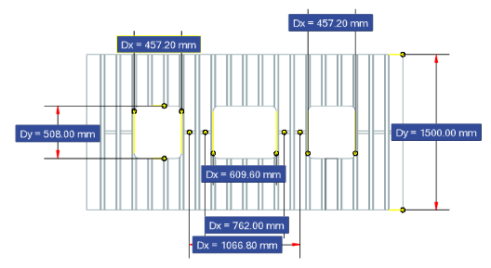
Press | Type | BOLSTER L-R | BOLSTER F-B | Common Coil Feed Height to Bols | STROKE | Common Shut Height | Minimum Shut Height | Maximum Shut Height | Ram Adjust | TONNAGE | Minimum Strokes P/Minute | Maximum Strokes P/Minute
PR11 | PROG | 3050 | 1500 | 425 | 300 | 620 | 575 | 875 | 300 | 400 | 40 | 70
PR11
PROG
Image with closed press
Hydraulic fixing system
Common Shut Height
250mm
FRONT FLOW
Locator T021
Common coil feed height with lifters extended
Distance between slots 6”
Bolster
425mm
Distance between locator

Slide 13
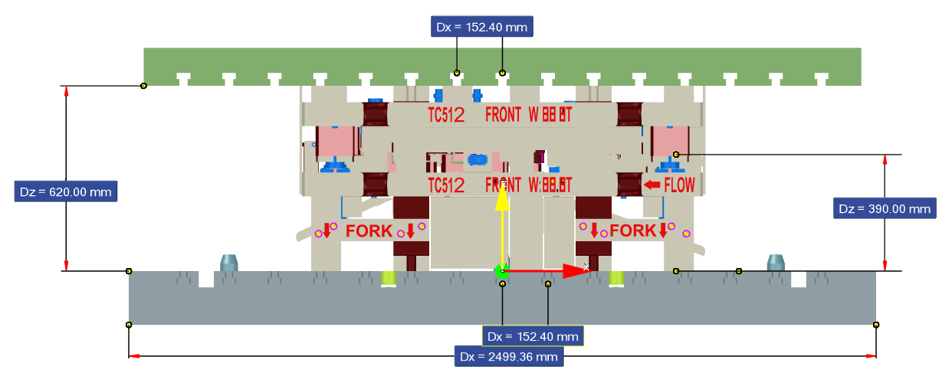
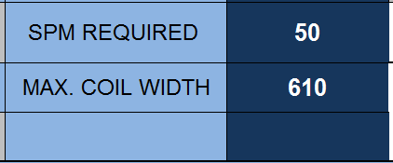
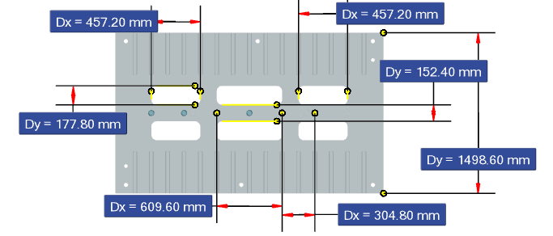
PR17
Press | Type | BOLSTER L-R | BOLSTER F-B | Common Coil Feed Height to Bols | STROKE | Common Shut Height | Minimum Shut Height | Maximum Shut Height | Ram Adjust | TONNAGE | Minimum Strokes P/Minute | Maximum Strokes P/Minute
PR17 | PROG | 2500 | 1500 | 425 | 300 | 620 | 409 | 639 | 200 | 300 | 10 | 50
PROG
Image with closed press
Distance between slots 6”
Common Shut Height
Common Coil Feed Height to Bols
425mm
250mm
FRONT FLOW
Distance between slots 6”
Common coil feed height with lifters extended
Bolster
425mm
Distance between locator
Locator T021

Slide 14
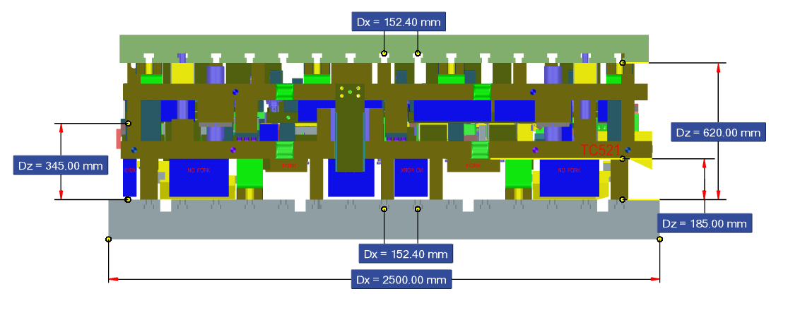
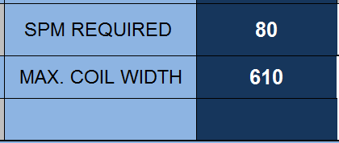
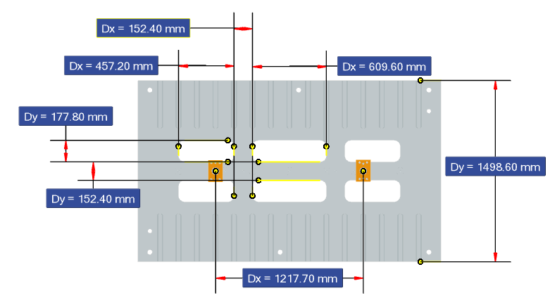
Press | Type | BOLSTER L-R | BOLSTER F-B | Common Coil Feed Height to Bols | STROKE | Common Shut Height | Minimum Shut Height | Maximum Shut Height | Ram Adjust | TONNAGE | Minimum Strokes P/Minute | Maximum Strokes P/Minute
PR18 | PROG | 2450 | 1250 | 425 | 250 | 620 | 552 | 702 | 150 | 660 | 30 | 60
PR 18
PROG
Image with closed press
Hydraulic fixing system
Distance between slots 6”
Common Shut Height
425 mm
Common coil feed height with lifters extended
200mm
FRONT FLOW
Distance between slots
425mm
Bolster
Locator T021
Distance between locator

Slide 15

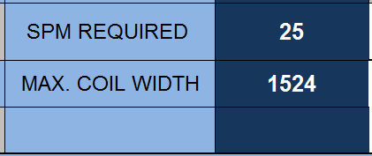
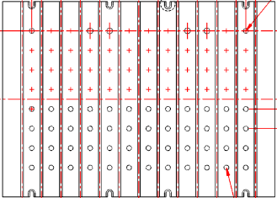
Press | Type | BOLSTER L-R | BOLSTER F-B | Common Coil Feed Height to Bols | STROKE | Common Shut Height | Minimum Shut Height | Maximum Shut Height | Ram Adjust | TONNAGE | Minimum Strokes P/Minute | Maximum Strokes P/Minute
PR22 | PROG | 2134 | 1524 | 330 | 356 | 787 | 660 | 864 | 203 | 500 | 25 | 25
PR22
PROG BLANKING
Common coil feed height with lifters extended
Image with closed press
Common Shut Height
787mm
330mm
2134mm
152.4mm
152.4mm
FRONT FLOW
Distance between slots 6”
1524mm

Slide 16
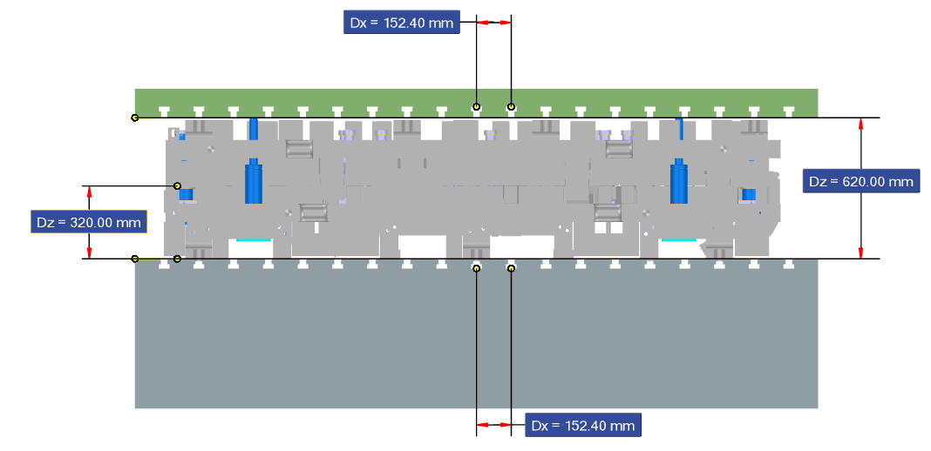
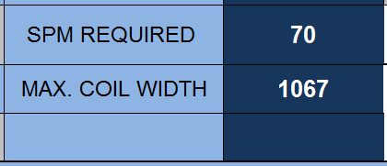
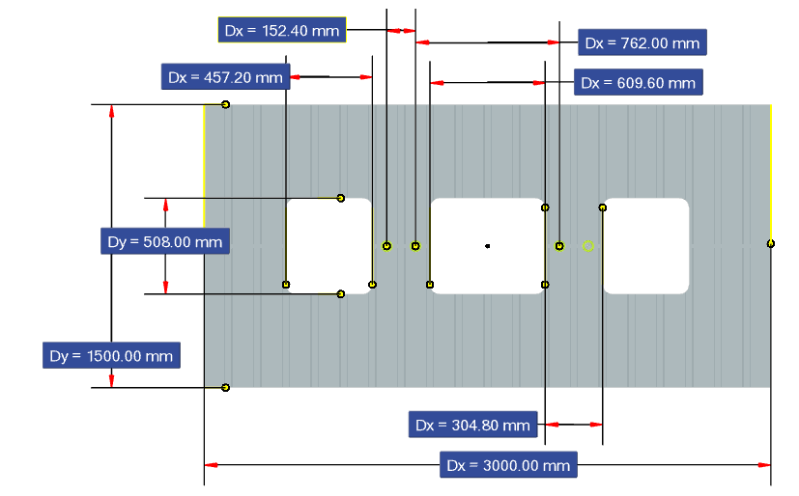
Press | Type | BOLSTER L-R | BOLSTER F-B | Common Coil Feed Height to Bols | STROKE | Common Shut Height | Minimum Shut Height | Maximum Shut Height | Ram Adjust | TONNAGE | Minimum Strokes P/Minute | Maximum Strokes P/Minute | Max Coil Width | Min Int. Dia Coil | Max Int. Dia Coil | Max Outside Dia Coil
PR30 | PROG | 3000 | 1500 | 425 | 300 | 620 | 560 | 860 | 300 | 400 | 25 | 70 | 1067 | 610 | 610 | 1829
PR30
Image with closed press
PROG
Hydraulic fixing system
Distance between slots 6”
Common Shut Height
Common coil feed height with lifters extended
FRONT FLOW
Distance between locator
Distance between slots
425mm
Locator T021

Slide 17
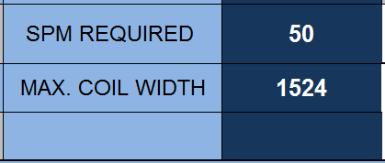
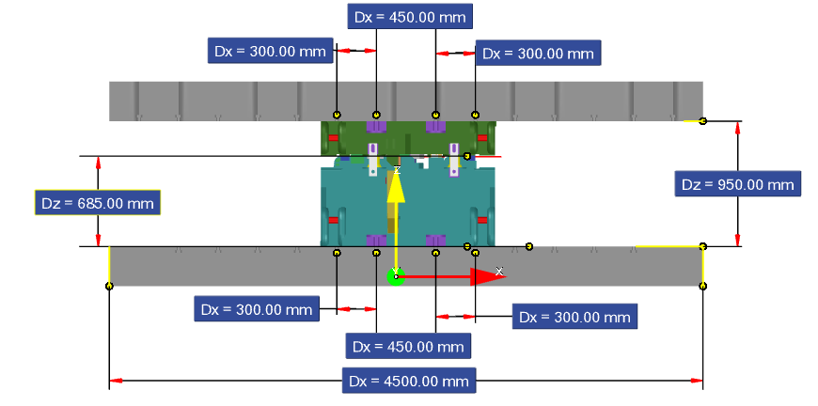
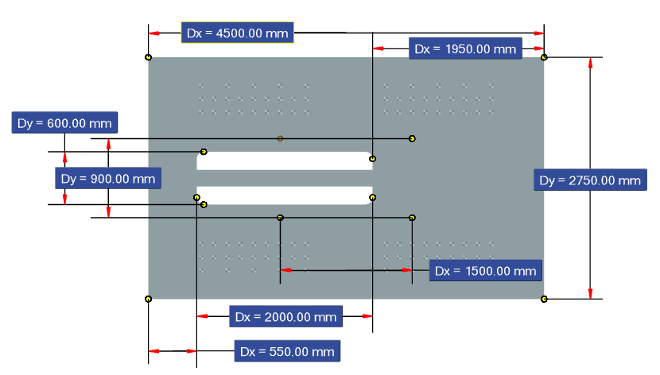
Press | Type | BOLSTER L-R | BOLSTER F-B | Common Coil Feed Height to Bols | STROKE | Common Shut Height | Minimum Shut Height | Maximum Shut Height | Ram Adjust | TONNAGE | Minimum Strokes P/Minute | Maximum Strokes P/Minute | Max Coil Width | Min Int. Dia Coil | Max Int. Dia Coil | Max Outside Dia Coil
PR32 | PROG | 4500 | 2750 | 600 | 320 | 1070 | 1050 | 1100 | 50 | 800 | 12 | 50 | 2000 | 400 | 610 | 2000
PR32
PROG BLANKING
Image with closed press
Distance between slots
Common Shut Height
1070mm
Common coil feed height with lifters extended
FRONT FLOW
Distance between slots
Bolster
Locator T020
600mm
Distance between locator

Slide 18
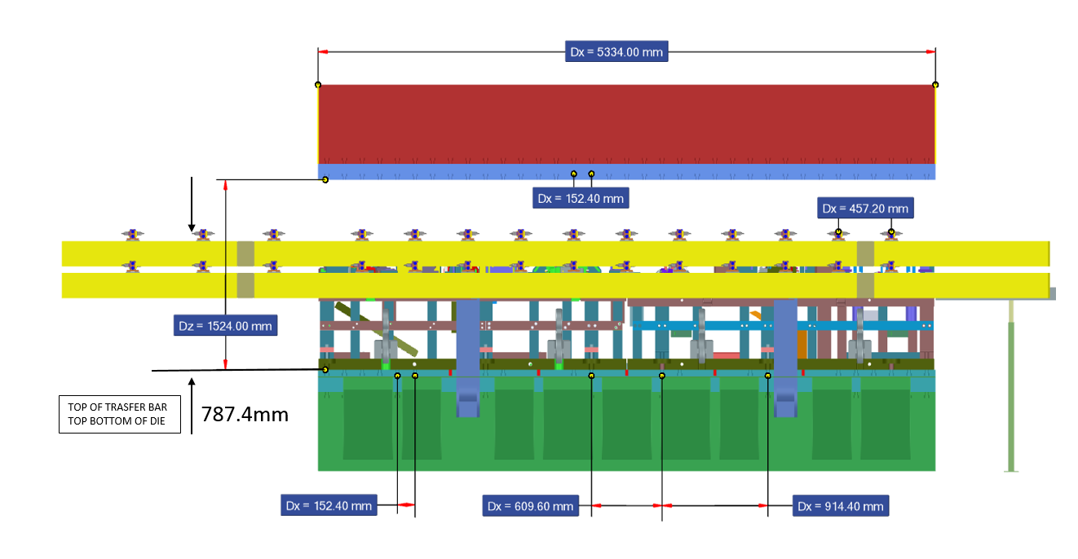
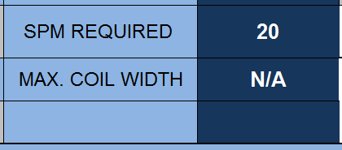
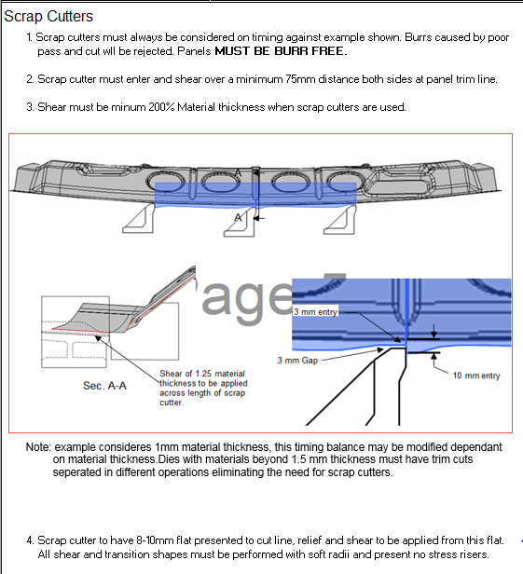
Press | Type | BOLSTER L-R | BOLSTER F-B | STROKE | Common Shut Height | Minimum Shut Height | Maximum Shut Height | Ram Adjust | TONNAGE | Minimum Strokes P/Minute | Maximum Strokes P/Minute | Transfer Lift | Max. Pitch / Transfer Pitch | Common Pitch | Max. Transfer Travel In & Out | Max. distance between trans. bars | Min. distance between trans. bars
PR23 | MECH/TANS | 5334 | 2438 | 762 | 1194 | 1118 | 1524 | 406 | 1500 | 6 | 20 | 25.4-254 | 1100 | 18,24,30,36,42 | 420mm | 2650 | 1200
PR23,PR24
MECH/TRANS
Image with closed press
Distance between slots
Common Shut Height
1194 mm
FRONT FLOW
Locator T020
Distance between slots

Slide 19
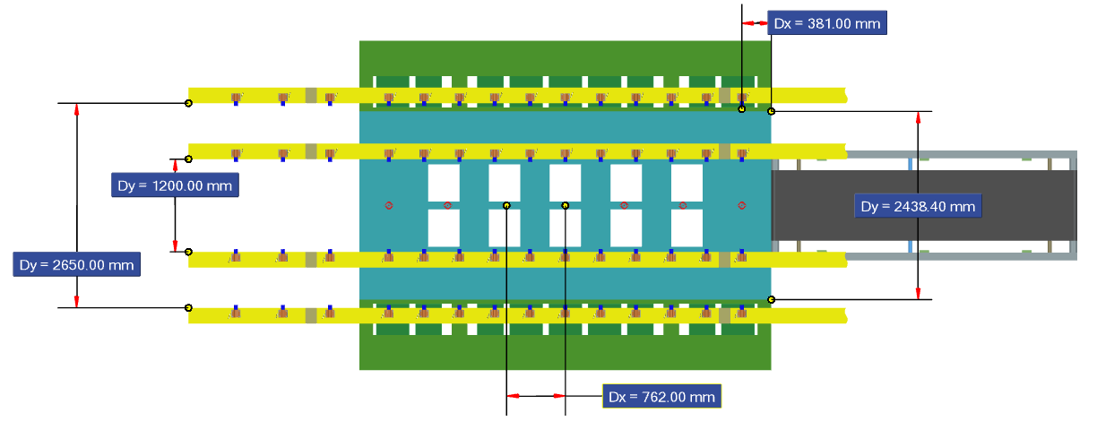

PR23,PR24
457.2mm
MECH/TRANS
FRONT FLOW
Distance between locator
Bolster
2438mm
Locator T020

Slide 20

Press | Type | BOLSTER L-R | BOLSTER F-B | STROKE | Common Shut Height | Minimum Shut Height | Maximum Shut Height | Ram Adjust | TONNAGE | Minimum Strokes P/Minute | Maximum Strokes P/Minute | Transfer Lift | Max. Pitch / Transfer Pitch | Common Pitch
PR25 | MECH/TANS | 5334 | 2388 | 762 | 1194 | 1117 | 1524 | 406 | 1500 | 6 | 20 | 25.4-254 | 1066.8 | 18,24,30,36,42
PR25
MECH/TRANS
Image with closed press
Common Shut Height
FRONT FLOW
Locator T020
Distance between slots

Slide 21


PR25
457.2mm
MECH/TRANS
FRONT FLOW
Bolster
Locator T020

Slide 22


Press | Type | BOLSTER L-R | BOLSTER F-B | Common Coil Feed Height to Bols | STROKE | Common Shut Height | Minimum Shut Height | Maximum Shut Height | Ram Adjust | TONNAGE | Minimum Strokes P/Minute | Maximum Strokes P/Minute | Max Coil Width | Min Int. Die Coil | Max Int. Dia Coil | Max Outside Dia Coil
PR26 | PROG | 5000 | 2500 | 787 | 610 | 850 | 787 | 1295 | 508 | 1000 | 15 | 30 | 1829 | 470 | 559 | 1880
PR26,PR27
COIL FEED
Image with closed press
Distance between slots
457.2mm
850 mm
Common Shut Height With Riser
FRONT FLOW
787mm
Distance between slots
RISER
Locator T020
Common coil feed height with lifters extended

Slide 23

PR26,PR27

Slide 24


PR26,PR27
Consider that the Transfer system is limited to the size of our BOLSTER.
Therefore, it must be consider that a work station will be destined for the fall of the piece.

Slide 25

RISER 26/27
Distance between locator
Locator T020

Slide 26






Press | Type | BOLSTER L-R | BOLSTER F-B | Common Coil Feed Height to Bols | STROKE | Common Shut Height | Minimum Shut Height | Maximum Shut Height | Ram Adjust | TONNAGE | Minimum Strokes P/Minute | Maximum Strokes P/Minute | Max Coil Width | Min Int. Dia Coil | Max Int. Dia Coil | Max Outside Dia Coil
PR31 | PROG | 3658 | 2134 | 787 | 508 | 910 | 864 | 1219 | 355 | 1000 | 13 | 26 | 1219 | 470 | 610 | 1778
PR31
COIL FEED
Image with closed press
Distance between slots
Common Shut Height With Riser
7787.34
Common Coil Feed Height to Bols
787mm
FRONT FLOW
Distance between slots
Common coil feed height with lifters extended
Distance between locator
Locator T020

Slide 27
PR31
Consider that the Transfer system is limited to the size of our BOLSTER.
Therefore, it must be consider that a work station will be destined for the fall of the piece.

Slide 28




PR A1
TANDEM
Image with closed press
Distance between slots
Common Shut Height
1879mm
1194mm
1194mm
Distance between slots
Locator T021

Slide 29



Press | Type | BOLSTER L-R | BOLSTER F-B | STROKE | Common Shut Height | Minimum Shut Height | Maximum Shut Height | Ram Adjust | TONNAGE | Minimum Strokes P/Minute | Maximum Strokes P/Minute
PRA2 | TANDEM | 4000 | 2500 | 660 | 1194 | 870 | 1220 | 350 | 800 | 4 | 10
PRA2,A3,A4,A5,A6
TANDEM
Image with closed press
Common Shut Height
1194mm
Distance between slots
Locator T021

Slide 30


Press | Type | BOLSTER L-R | BOLSTER F-B | STROKE | Minimum Shut Height | Maximum Shut Height | Minimum Shut Height OUT | Maximum Shut Height OUT | Ram Adjust | TONNAGE OUTER | TONNAGE INER | Minimum Strokes P/Minute | Maximum Strokes P/Minute
PRB1 | TANDEM | 3200 | 2082 | INNER 914 OUTER 686 | 1676 INNER | 2286 INNER | 1574 OUTER | 2184 OUTER | 609 | 1250 | 2000 | 4 | 10
PRB1
TANDEM
Image with closed press
Common Shut Height
Minimum shut Height OUT
1400mm
Distance between slots
Locator T021

Slide 31


Press | Type | BOLSTER L-R | BOLSTER F-B | STROKE | Common Shut Height | Minimum Shut Height | Maximum Shut Height | Ram Adjust | TONNAGE | Minimum Strokes P/Minute | Maximum Strokes P/Minute
PRB2 | TANDEM | 4000 | 2500 | 660 | 1194 | 870 | 1220 | 350 | 800 | 4 | 10
PR B2,B3
TANDEM
Image with closed press
Distance between slots
Common Shut Height
Distance between slots
Locator T021

Slide 32


Press | Type | BOLSTER L-R | BOLSTER F-B | STROKE | Common Shut Height | Minimum Shut Height | Maximum Shut Height | TONNAGE | Minimum Strokes P/Minute | Maximum Strokes P/Minute
PRB4 | TANDEM | 3048 | 2134 | 813 | 1194 | 1168 | 1305 | 800 | 12 | 12
PR B4
TANDEM
Image with closed press
Distance between slots
Common Shut Height
1194mm
Distance between slots
Locator T021

Slide 33

1-8-2018 We add ´transfer curves to press 24,25,26
2-8-2018 Modification in the press 11 information .(common shut height ).
10-8-2018 Modificación in the HS información. (common shut height ).
10-8-2018 We add preferred load height information to press HS
28/8/2018 we add information of SPM and max coil width.

